Slide 1
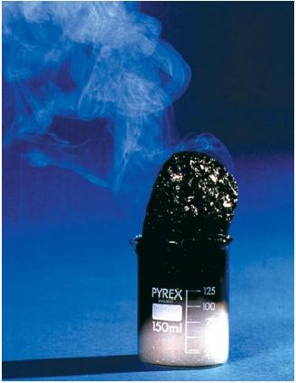
Properties of Matter

Slide 2
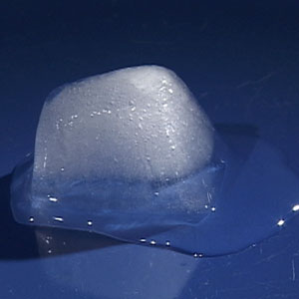
Physical Properties
Physical Change - When the shape or state is altered, but the substance stays the same.

Slide 3
States of Matter
When a state changes, it is a physical change because the substance remains the same.

Slide 4
Physical Properties
Properties of a substance that relate to the kinds of physical changes that take place

Slide 5
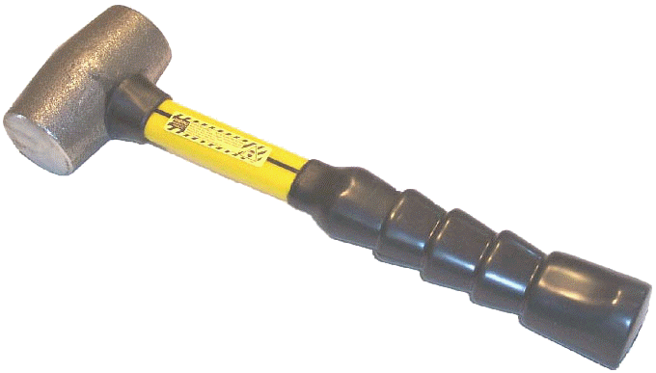
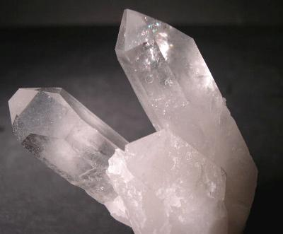
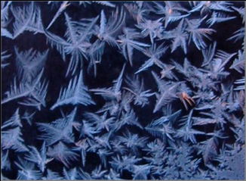
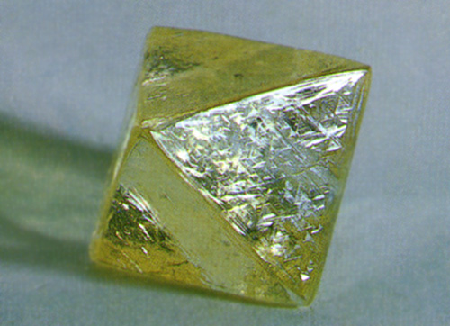
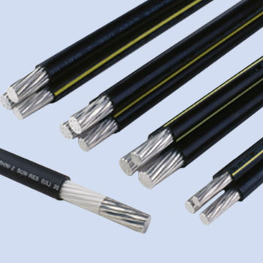
Physical Properties

Slide 6
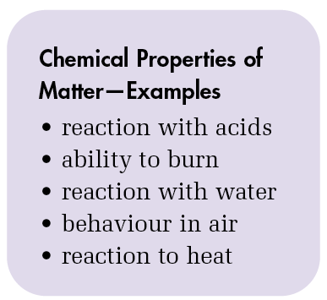
Chemical Properties
How a substance interacts with other substances.
Chemical properties can be onserved when a substance reacts and changes into a different substance (a chemical change)

Slide 7
Example: Water
What are the physical properties of water?

Slide 8
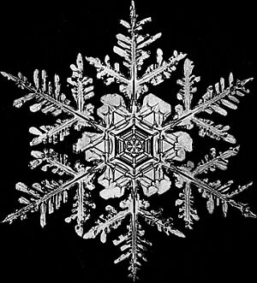
Water
Colourless
Mp = 0 ᵒC
Bp = 100ᵒC
Crystal shape - hexagonal
Density = 1 g/mL
Conductivity: Pure water is an insulator, however, when salts are dissolved in water, it conducts electricity very well.

Slide 9
Example: Water
What are some chemical properties of water?

Slide 10
Example: Water
No reaction to acids
Non flammable
No reaction to water
No reaction to air
No reaction to heat

Slide 11
Example: Baking Soda
What are the physical properties of baking soda?

Slide 12
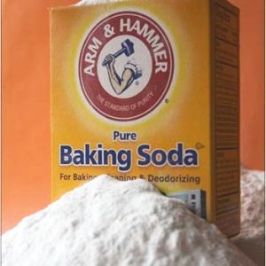
Baking Soda
White
Mp = 50 ᵒC
Bp = 851ᵒC
Crystal shape – fine white powder
Density = 2.20 g/mL
Conductivity: poor

Slide 13
Example: Baking Soda
What are some chemical properties of baking soda?
reaction with acid
reaction to heat

Slide 14
Example: Baking Soda
reaction to acids: gas released (carbon dioxide)
Non flammable
No reaction to water
No reaction to air
reaction to heat: gas and liquid is released

Slide 15
Example: Magnesium
What are the physical properties of magnesium?

Slide 16
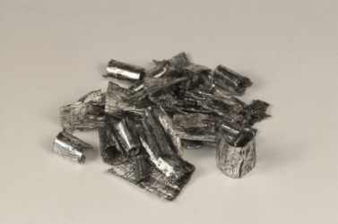
Magnesium
Silver
Mp = 650 ᵒC
Bp = 1091ᵒC
Crystal shape N/A
Density = 1.58 g/mL
Conductivity: good conductor

Slide 17
Example: Magnesium
What are some chemical properties of magnesium?
reaction to acid
reaction to heat

Slide 18
Example: Magnesium
reaction to acids: gas released (hydrogen)
Highly flammable
No reaction to water
No reaction to air
No reaction to heat: (unless oxygen is present)

